Slide 1
Bridging the Gap
A Design Thinking Approach to Graduation Management
Hosts: Danielle Beetge & Robyn Harris | Session 85-87

Slide 2
Agenda
Best practice
What are your pain points?
Process: beginning to end
How are you measured?

Slide 3
Best practices are sets of methods and techniques that produce optimal results, increase efficiency and develop structured processes.

Slide 4
Easier to learn
Faster to use
Cheaper to develop
Creates supportive community

Slide 5
Easier to learn
Faster to use
Cheaper to develop
Creates supportive community

Slide 6
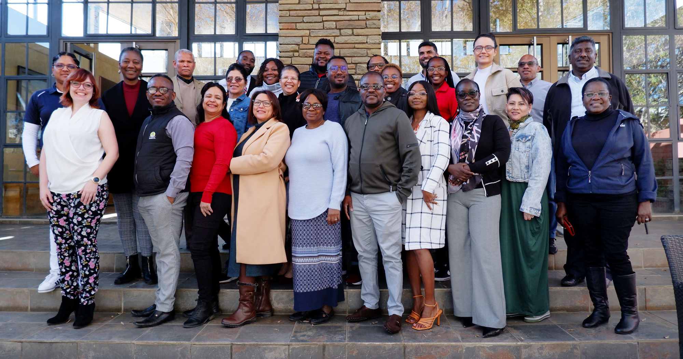
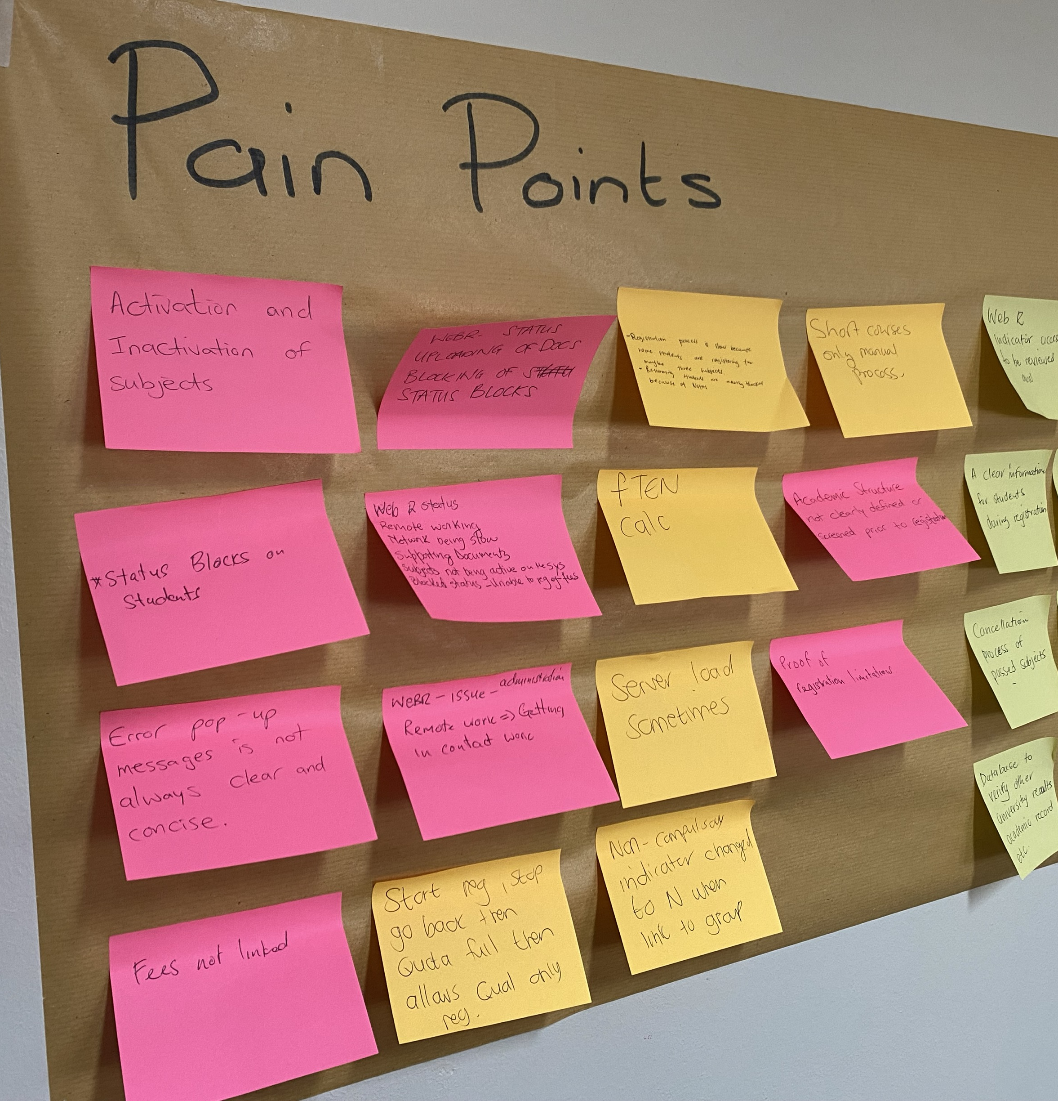
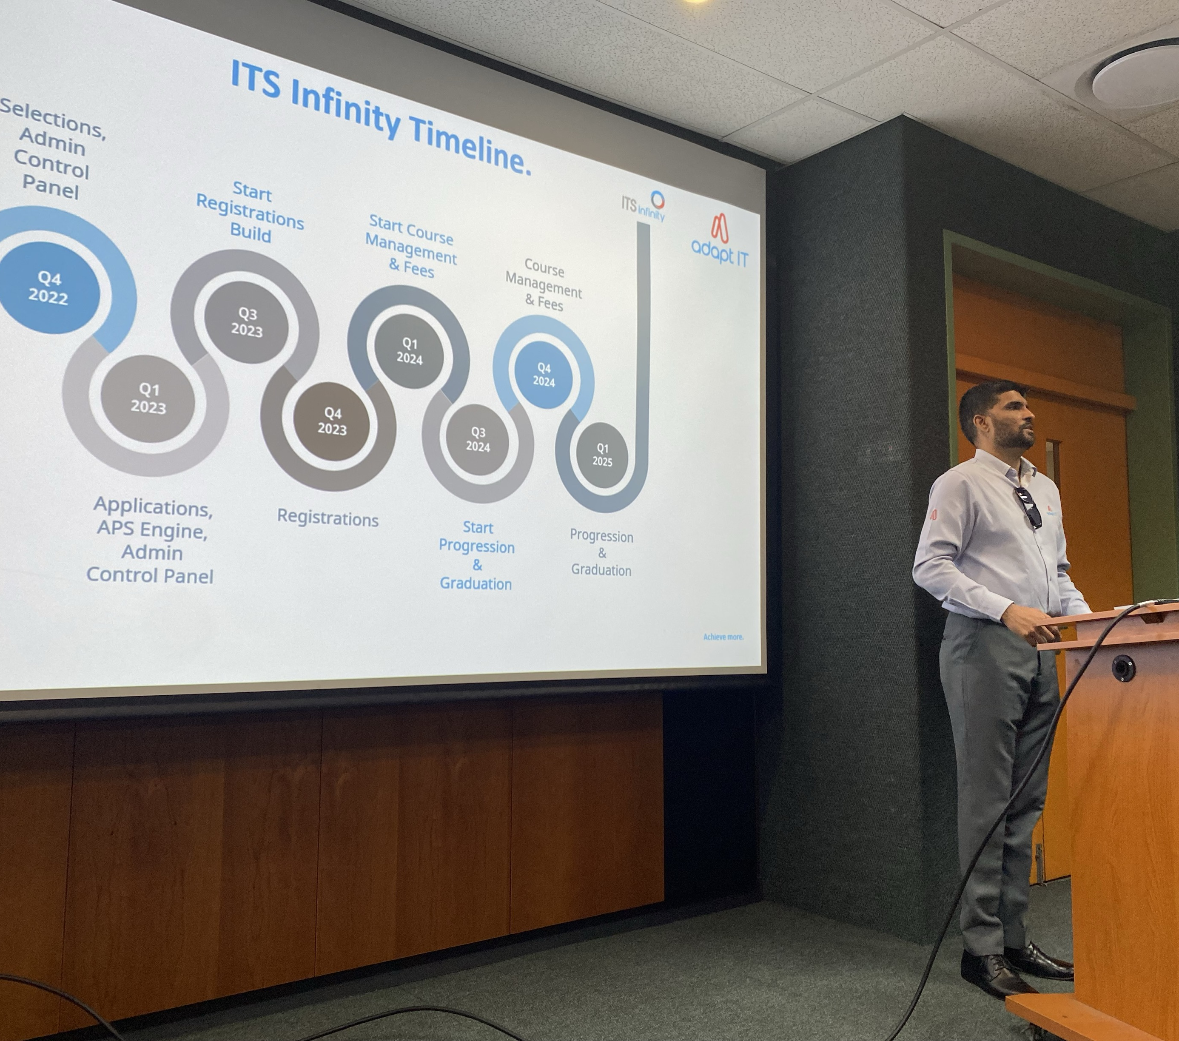
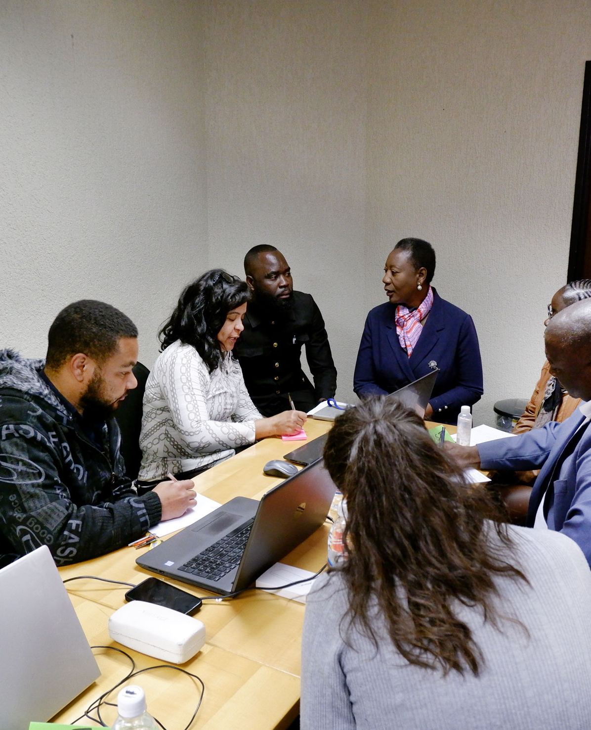
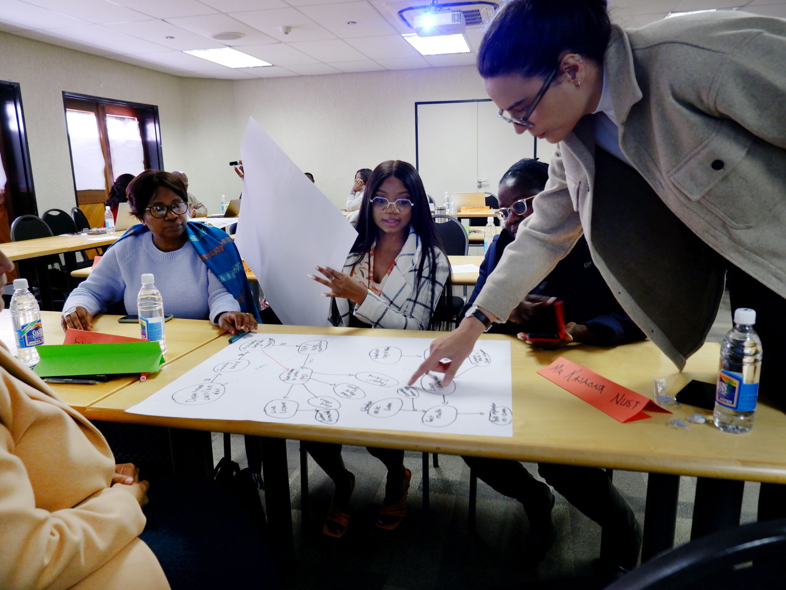
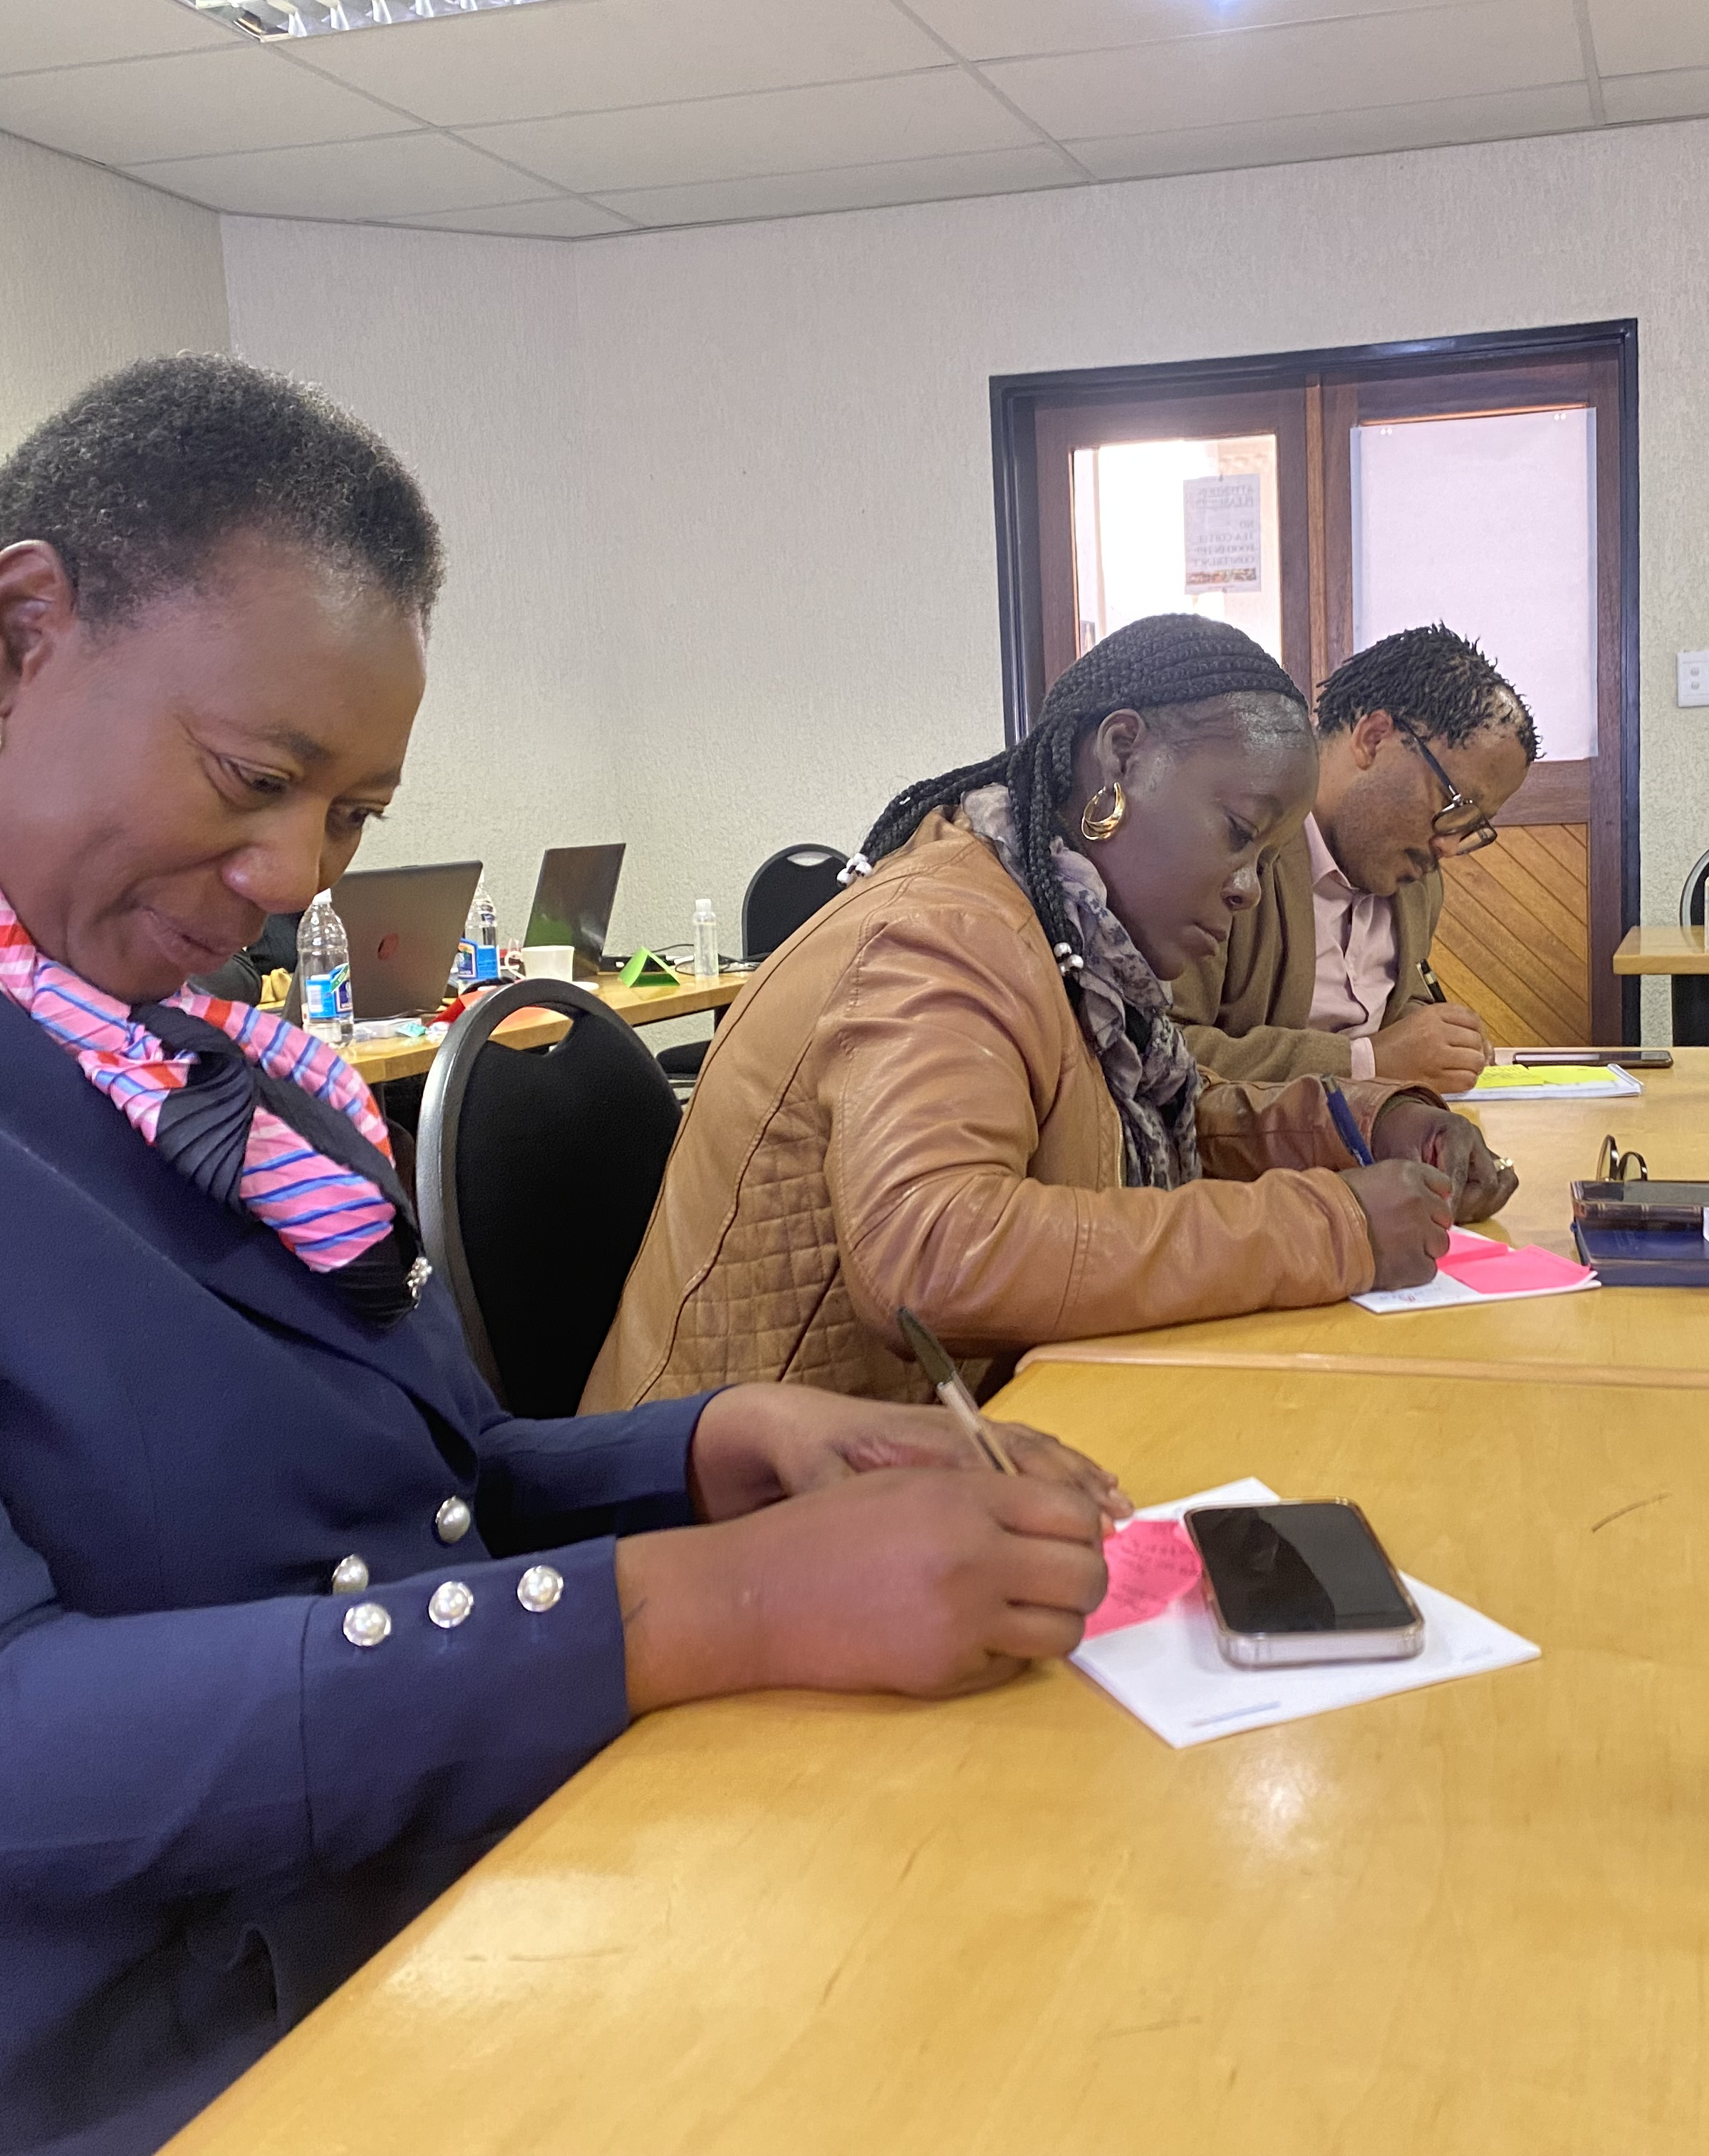
You are now part of that community

Slide 7
Personas Involved
Head: Graduations
Graduation Officer
Administrator: Graduation
Manager: Assessment & Graduation
Deputy Director: Assessment & Graduation
Deputy Registrar: Assessment, Certification & Graduation
Asst Registrar: Assessments & Graduation

Slide 8
What are your pain points regarding graduation management?
Join at menti.com | use code 72242496

Slide 9
No clear visible overview
No clear communication
No way of knowing/seeing, after setup, what is still pending and what effects what where.
No clear step by step flow everything is jumbled, jump between menu options
If there is a change made that effects us we have know way of instantly knowing
Incorrect or contradictory rules result in a student not graduating. Registration, graduation and progression rules need to be aligned.
Other dependencies not setup correctly (quotas, academic structure etc.)
Usability
System
Maintaining the rules is too difficult, the way how we create rules needs to be simplified
We don’t know what impacts what and why
No way to effectively transfer the student from old qualification to newly changed qualification, linkage is difficult. This is where the issue comes with student not being able to graduate.
Do not know how to capture their rules in the system so that it makes sense, system is very technical.

Slide 10
Process: Beginning to End

Slide 11
What does your business processes look like?
Join at menti.com | use code 72242496
Notes:
Pre-checklist “Auto Progress” should be set to "Y" {SSTUDD-2} Criteria per Period of Study. A Census Record for the year to which the students should be promoted must exist on {GOPS-1}. The Academic Structure must exist for the year to which the student will be promoted to. The event codes P1 and P2 must be linked to applicable admission status codes in {SCAO1-6} Result Code indicators should be set up in {SCODE-23}. Specify if the result code Period of Study sequences should be set up carefully in {SCODE-30}. The "Pre-requisites" qualifications should be set up carefully in {SACADO-6}. A Census Record for the year and block code to which the students should be promoted must exist on {GOPS-1}. Set QU validation on {SMNT-1} to determine if quota should be checked (Y) or not (N) on {SACADO-5}

Slide 12
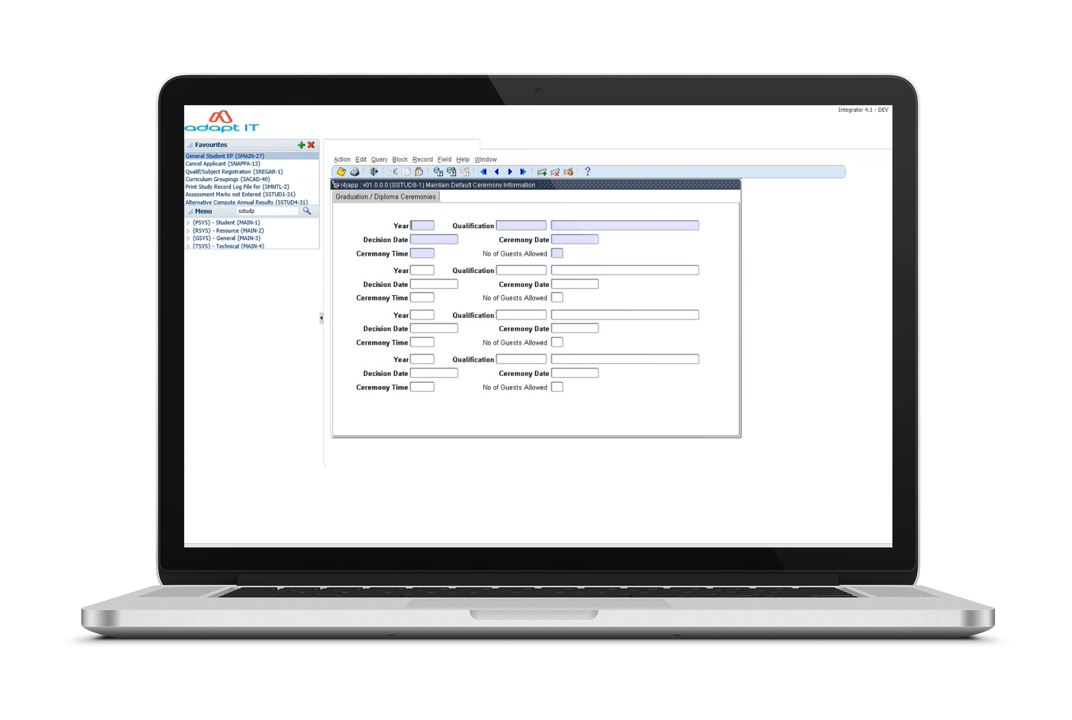
{SSTUD8-1}
Maintain Default Ceremony Information

Slide 13
{SSTUD8-1}
Maintain Default Ceremony Information

Slide 14
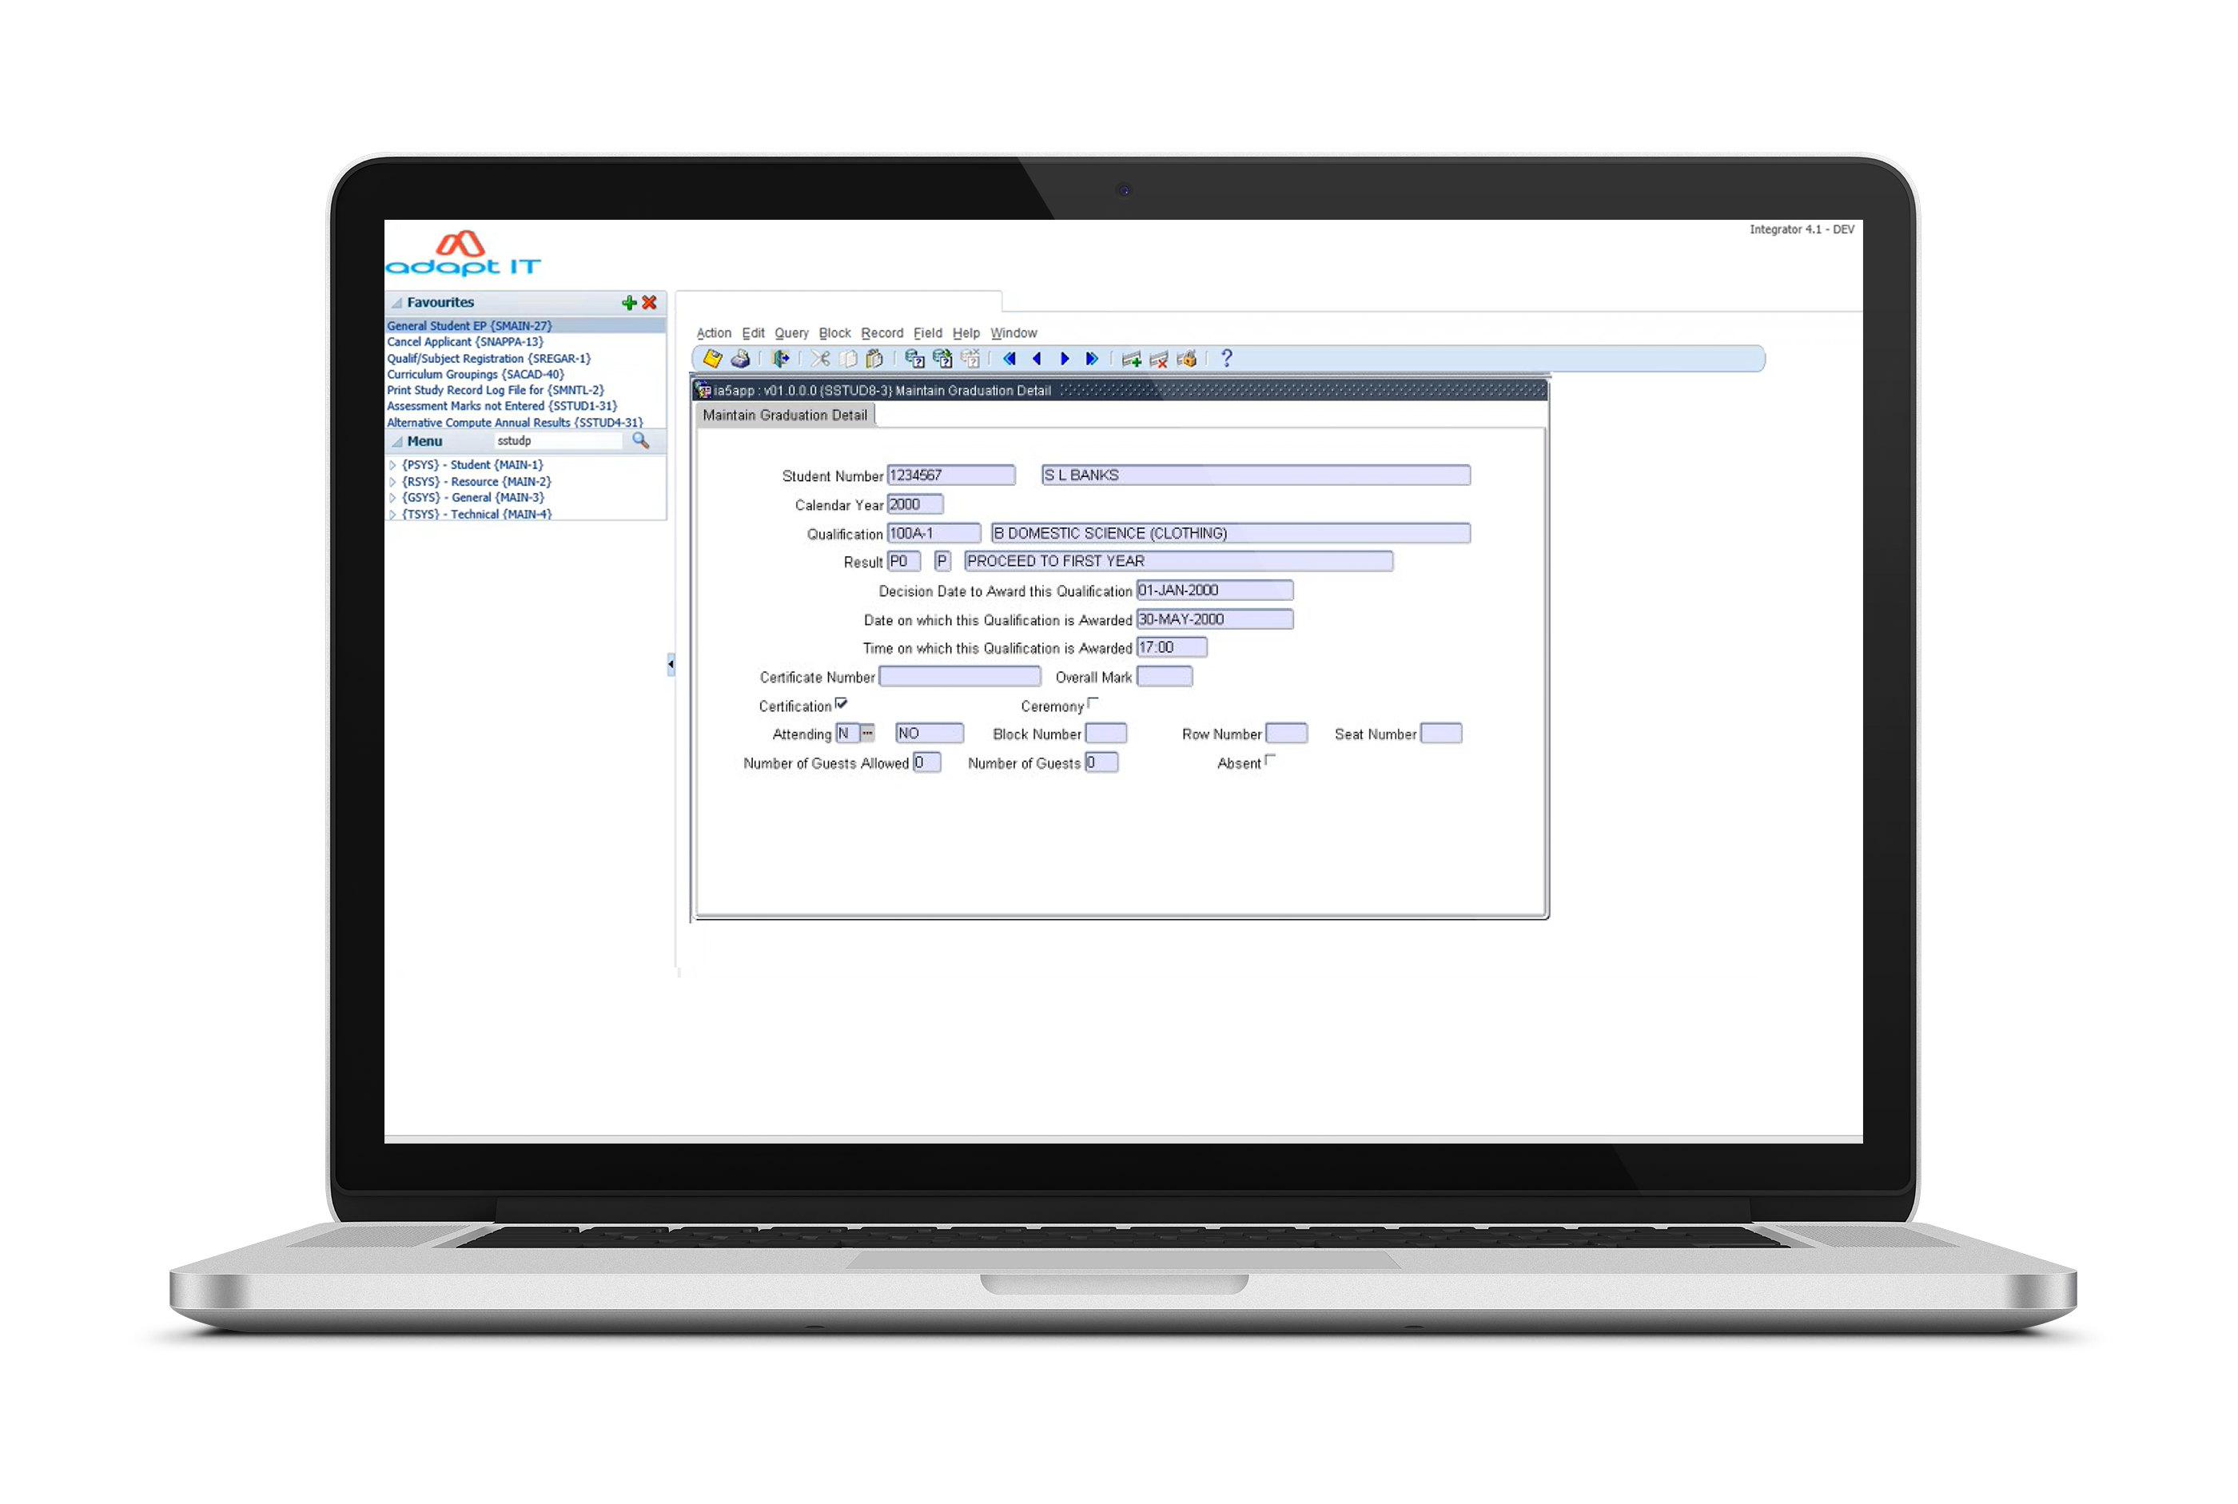
{SSTUD8-3}
Maintain Graduation Detail

Slide 15
{SSTUD8-3}
Maintain Graduation Detail

Slide 16
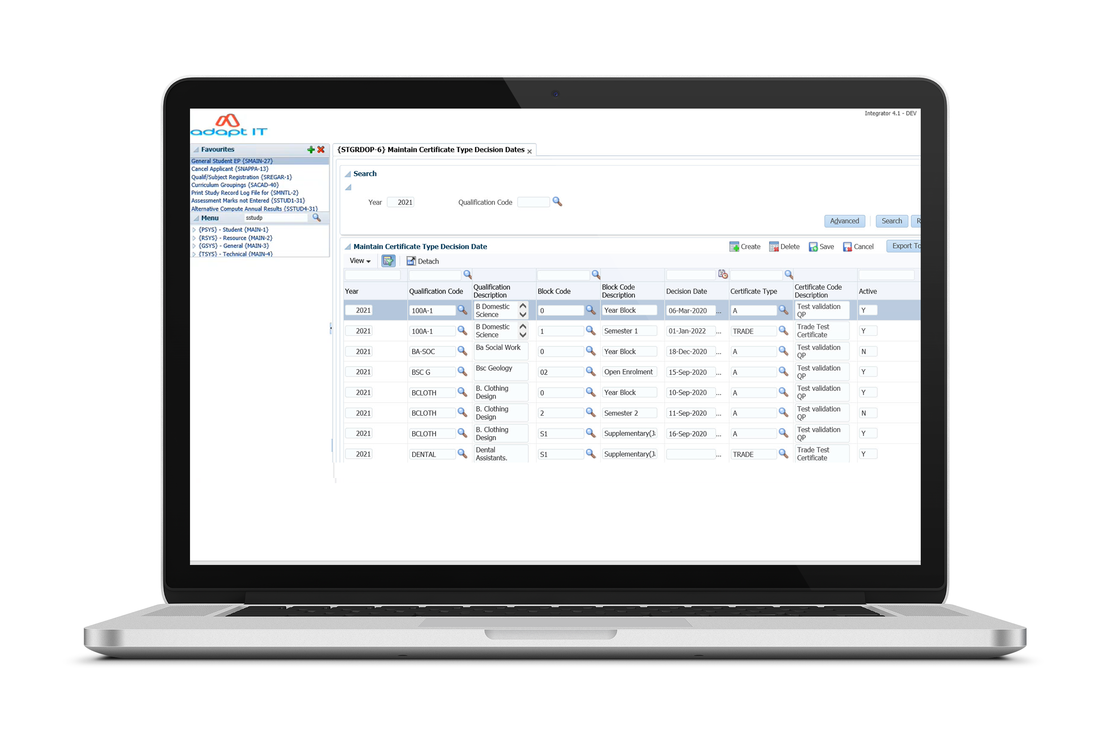
{STGRDOP-6}
Maintain Certificate Type Decision Dates

Slide 17
{STGRDOP-6}
Maintain Certificate Type Decision Dates

Slide 18
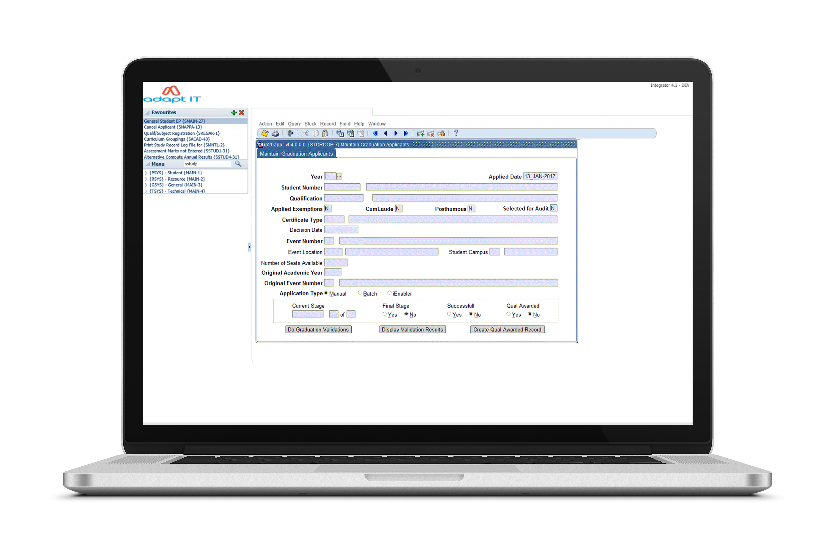
{STGRDOP-7}
Maintain Graduation Applicants

Slide 19
{STGRDOP-7}
Maintain Graduation Applicants

Slide 20
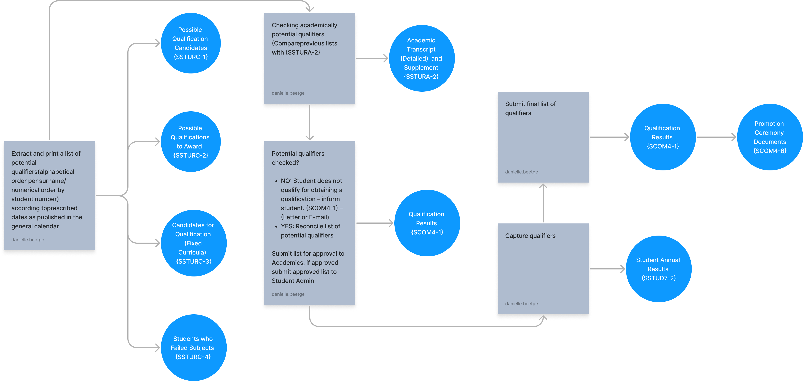
Identifying Potential Qualifiers

Slide 21
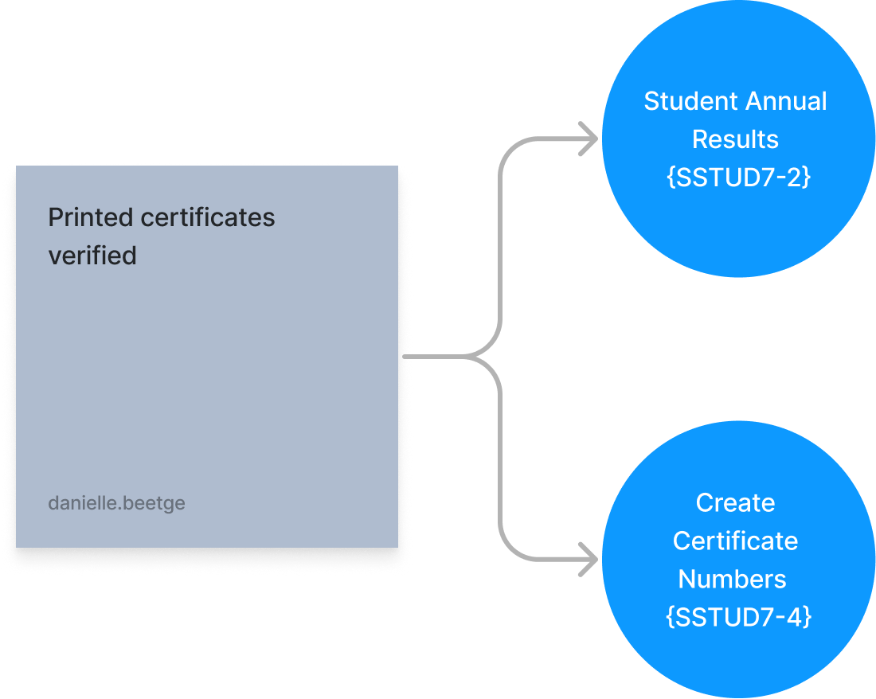
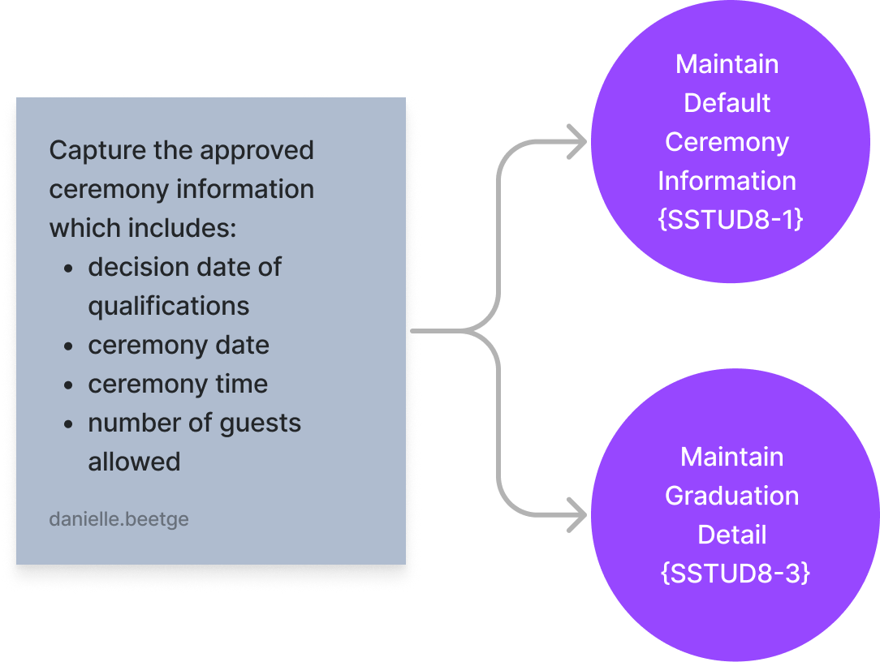
Printing of Certificates
Preparation for Graduation

Slide 22
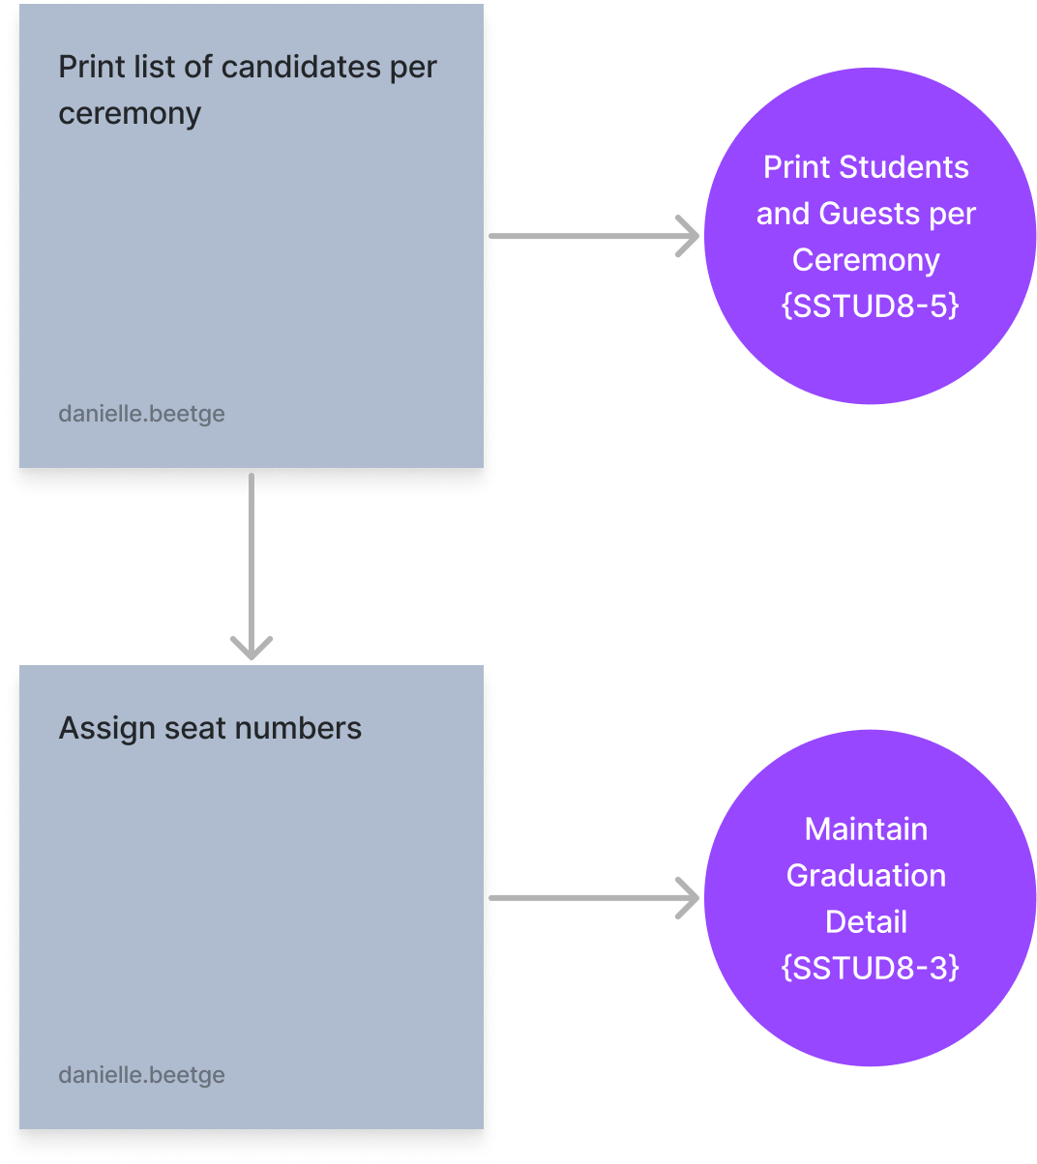
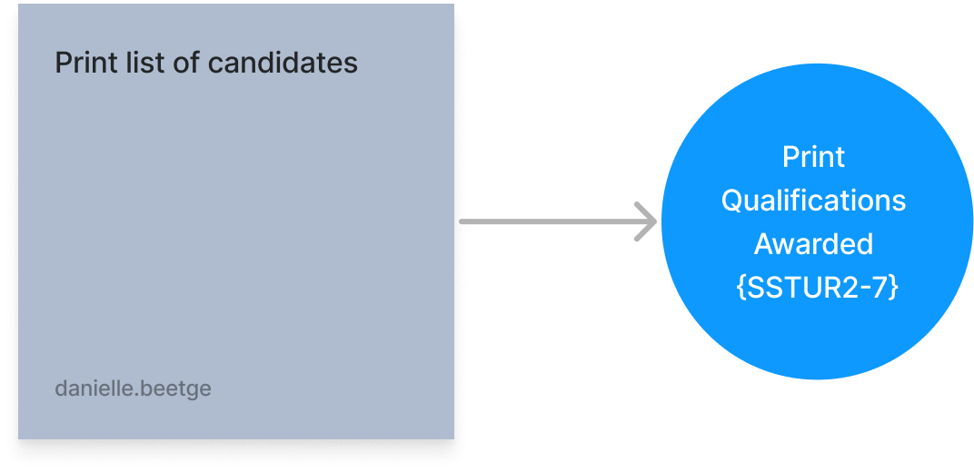
Printing of Graduation Entrance Cards
Compiling and Printing of a Graduation Program

Slide 23
Draw out your business process.
10 min - Group

Slide 24
What do need to report on?
Join at menti.com | use code 72242496
Notes:
Pre-checklist “Auto Progress” should be set to "Y" {SSTUDD-2} Criteria per Period of Study. A Census Record for the year to which the students should be promoted must exist on {GOPS-1}. The Academic Structure must exist for the year to which the student will be promoted to. The event codes P1 and P2 must be linked to applicable admission status codes in {SCAO1-6} Result Code indicators should be set up in {SCODE-23}. Specify if the result code Period of Study sequences should be set up carefully in {SCODE-30}. The "Pre-requisites" qualifications should be set up carefully in {SACADO-6}. A Census Record for the year and block code to which the students should be promoted must exist on {GOPS-1}. Set QU validation on {SMNT-1} to determine if quota should be checked (Y) or not (N) on {SACADO-5}

Slide 25
Contributors​
Pravie Govender Pravie.Govender@adaptit.com
Clinton Naidu Clinton.Naidu@adaptit.com
Linda Putu linda.putu@adaptit.com
Thato Mthembu Thato.Mthembu@adaptit.com
David Goodrum
david.goodrum@adaptit.com
Shannon Naidoo Shannon.Naidoo@Adaptit.com
Claire Marais
claire.marais@adaptit.com
Danielle Beetge Danielle.Beetge@adaptit.com
Robyn Harris
robyn.harris@adaptit.com

